Slide 1

Business Case

Slide 2

About us:
Consulting Firm on Automotive Market

Slide 3

About our client:
Name: Auto+
Industry: Auctions of used cars
Country: USA
Customers: Auto buyers
Scope: To open its first Dealership in USA

Slide 4
Report’s Targets:
To understand customers’ preferences on USA’s used cars auction market
2) Find Auto+ entry-market Stock
3) Find the best State to open

Slide 5

Dataset

Slide 6
Dataset
Name: used-car-auction-prices.csv
Found in: https://www.kaggle.com/tunguz/used-car-auction-prices
Contains Data About: used car auction sales in the USA for three months in 2014 & seven months in 2015
Number of rows: 558.837
Number of columns: 16

Slide 7
Dataset
Columns:
year : The construction year of the car
make: The manufacturer of the car
model: The model of the car
trim: The trim of the car
body: The body type of the car
transmission: Whether the car is automatic or manual
vin: A unique code for the car
state: The state where the car was sold
condition: The condition of the car
odometer: The total number of miles the car has completed
color: The exterior color of the car
interior: The interior color of the car
seller: The name of the seller
mmr: The Manheim Market Report (MMR) is the premier indicator of wholesale price
sellingprice: The price that the car was sold
saledate: The date when the car was sold

Slide 8

Data Cleaning

Slide 9
Data Cleaning
Search for missing values

Slide 10
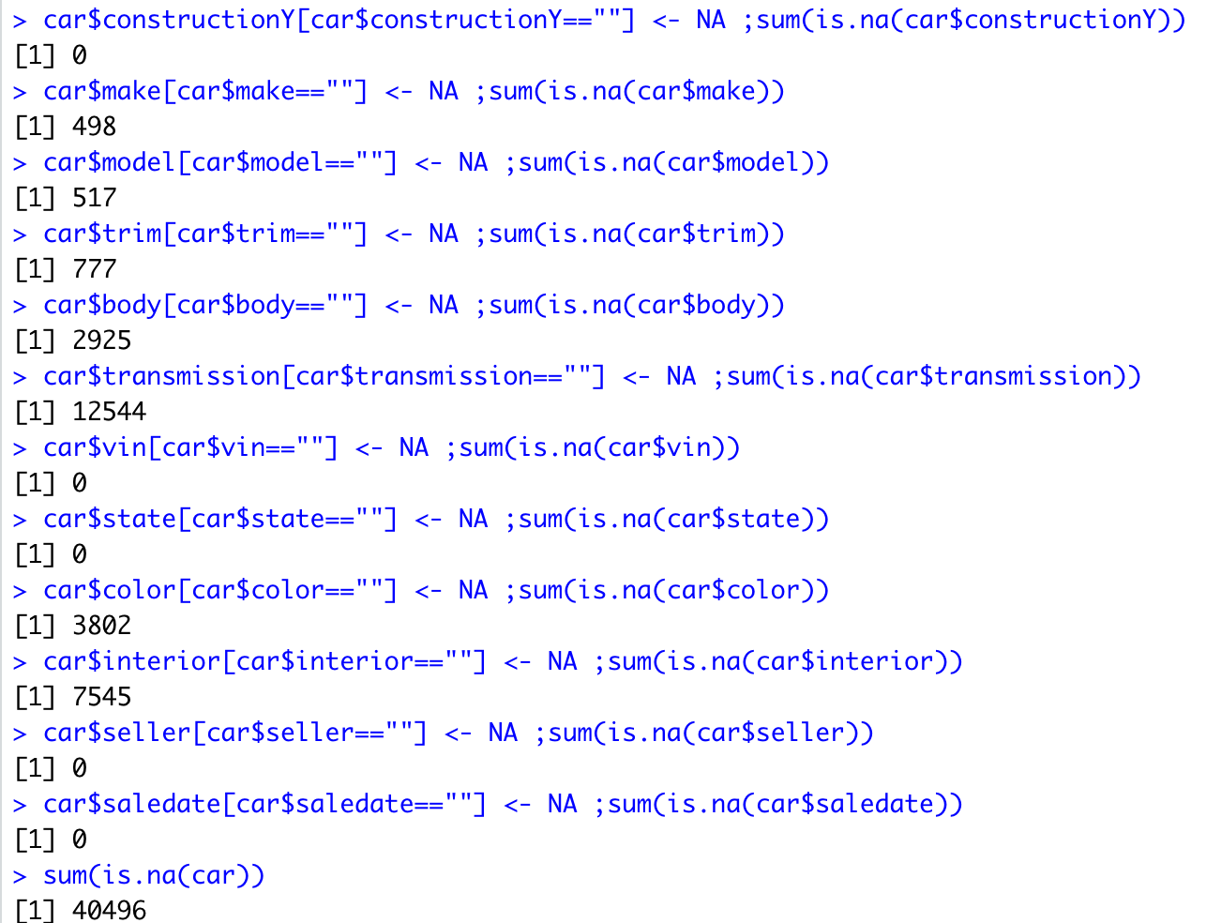

Slide 11
Data Cleaning
Search for missing values
Transfer mismatched columns 1 column to the left

Slide 12
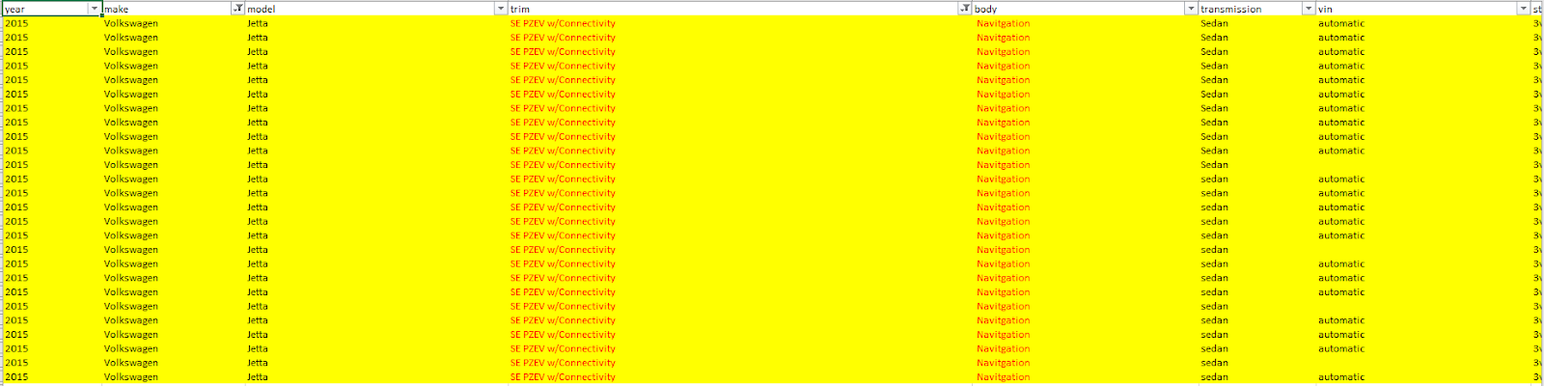
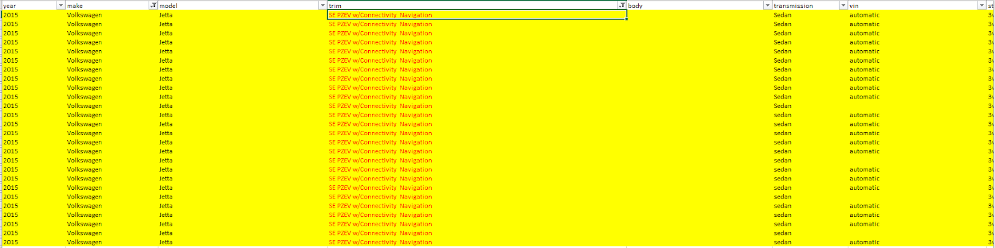

Slide 13
Data Cleaning
Search for missing values
Transfer mismatched columns 1 column to the left
Change unknown values to blanks

Slide 14
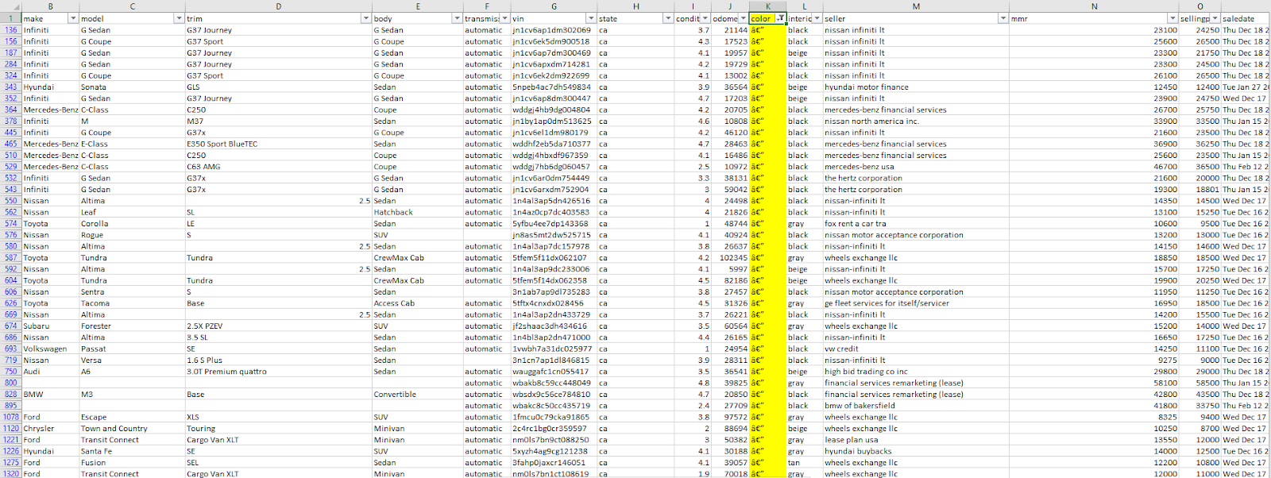
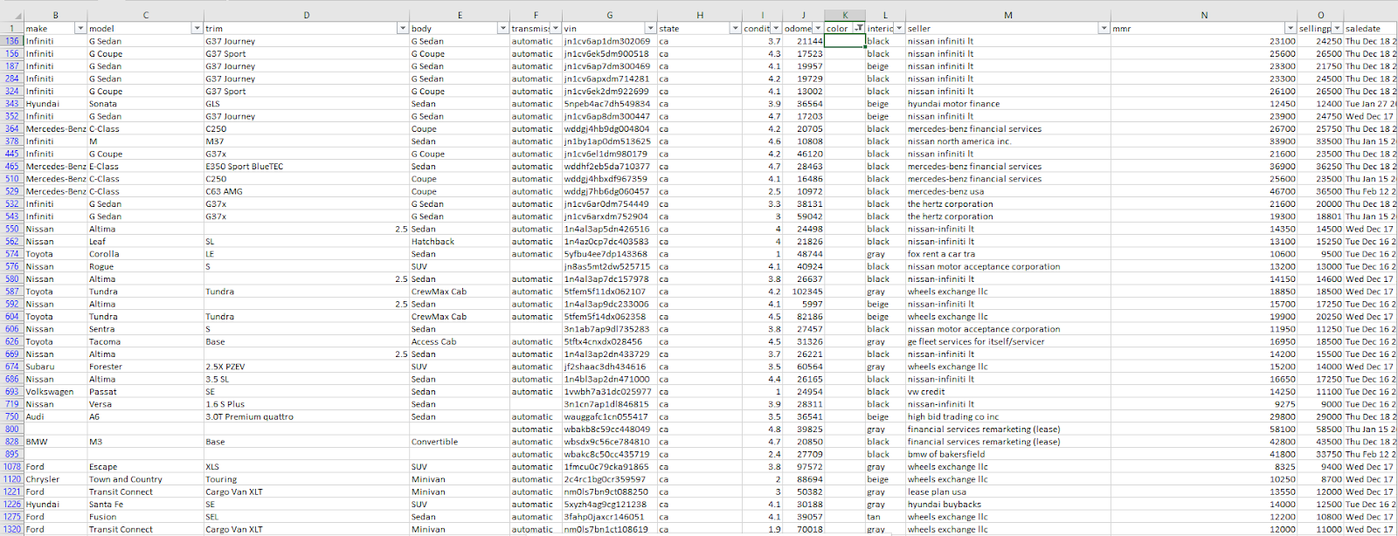

Slide 15
Data Cleaning
Search for missing values
Transfer mismatched columns 1 column to the left
Change unknown values to blanks
Add autoID column

Slide 16
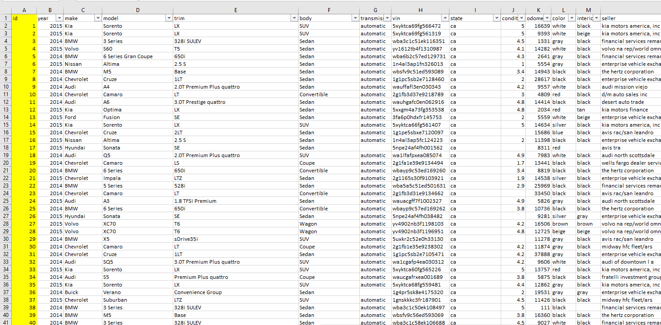

Slide 17
Data Cleaning
Search for missing values
Transfer mismatched columns 1 column to the left
Change unknown values to blanks
Add autoID column
Split salesdate column into 4 columns

Slide 18
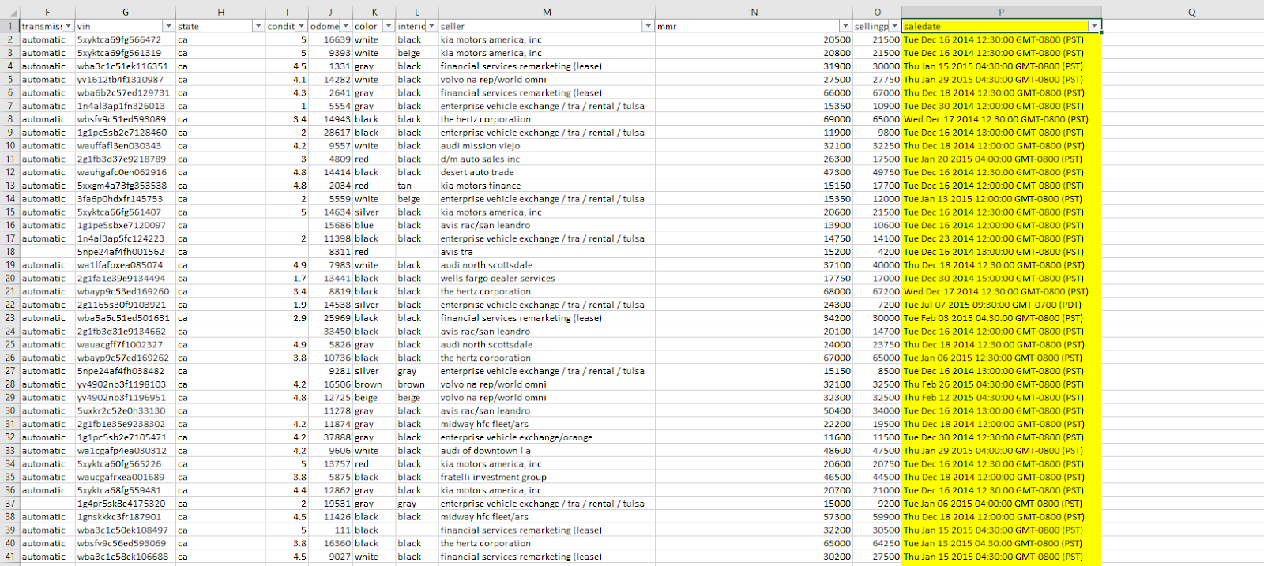
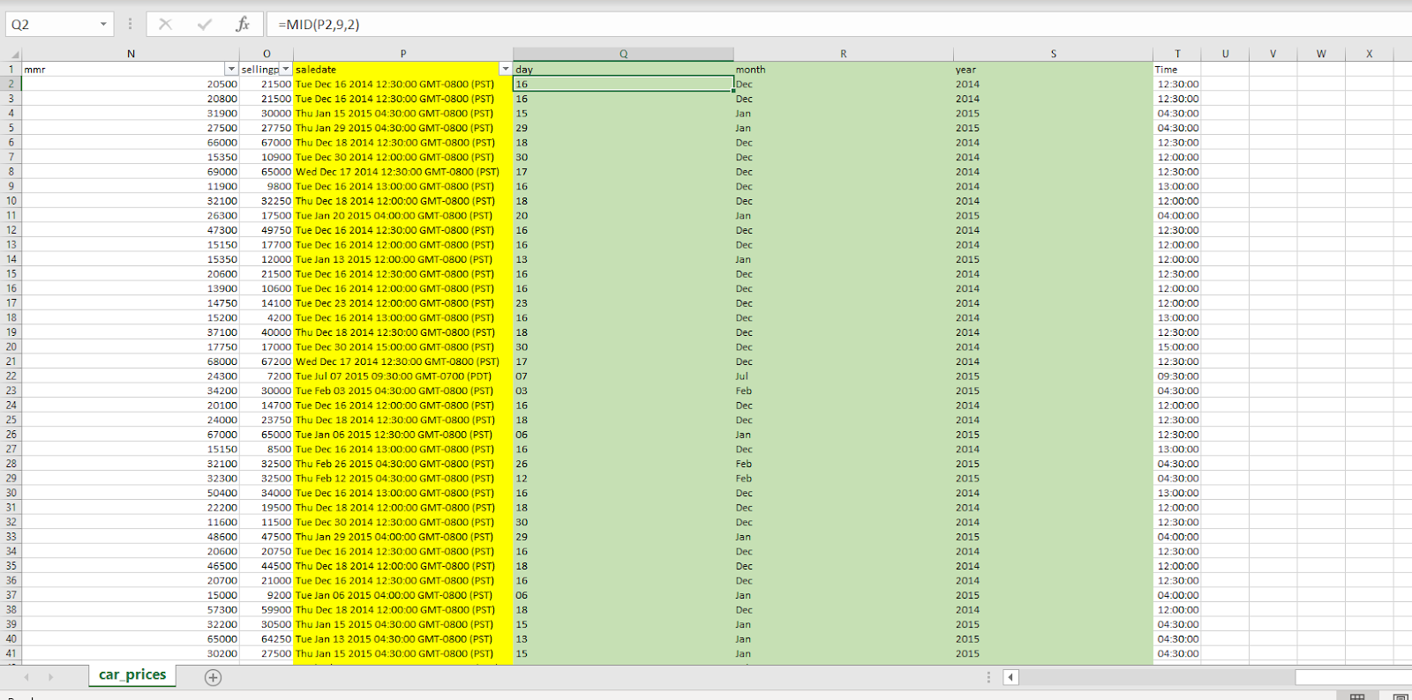
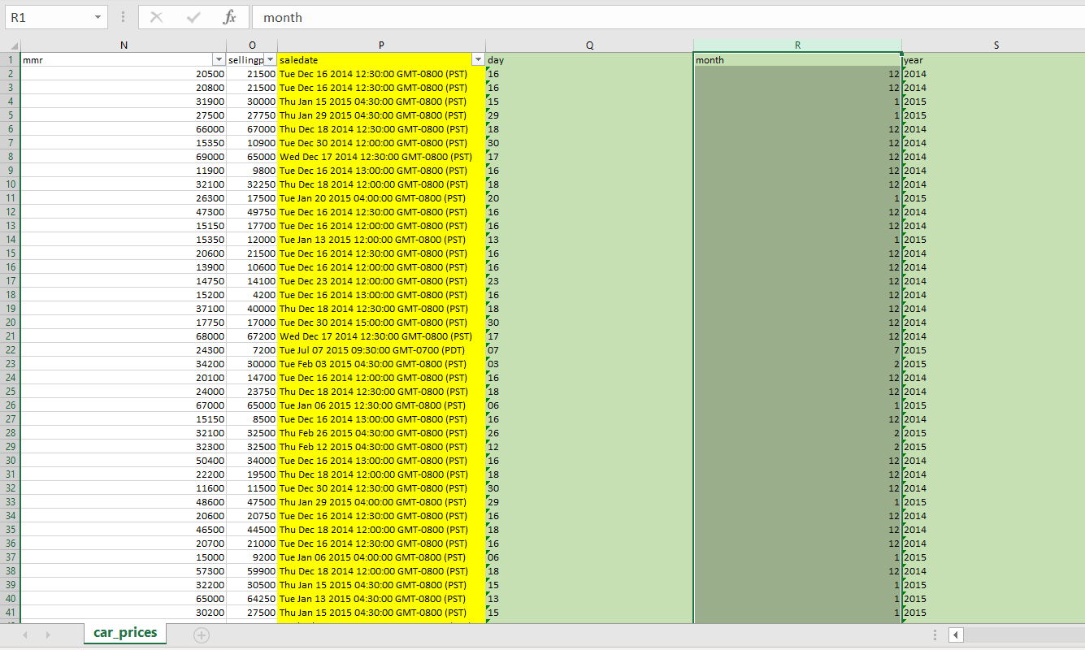

Slide 19
Data Cleaning
Search for missing values
Transfer mismatched columns 1 column to the left
Change unknown values to blanks
Add autoID column
Split salesdate column into 4 columns
Replace missing values of Dimensions with N/As

Slide 20
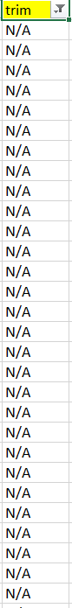
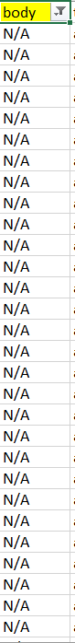
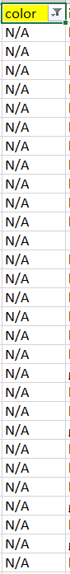
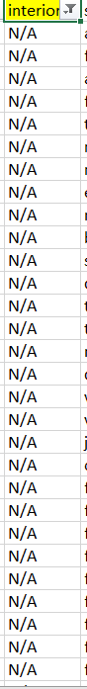
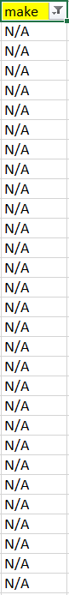
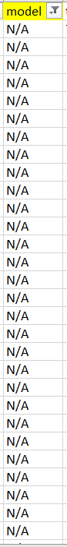
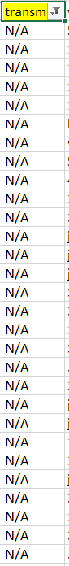

Slide 21

Star Schema

Slide 22
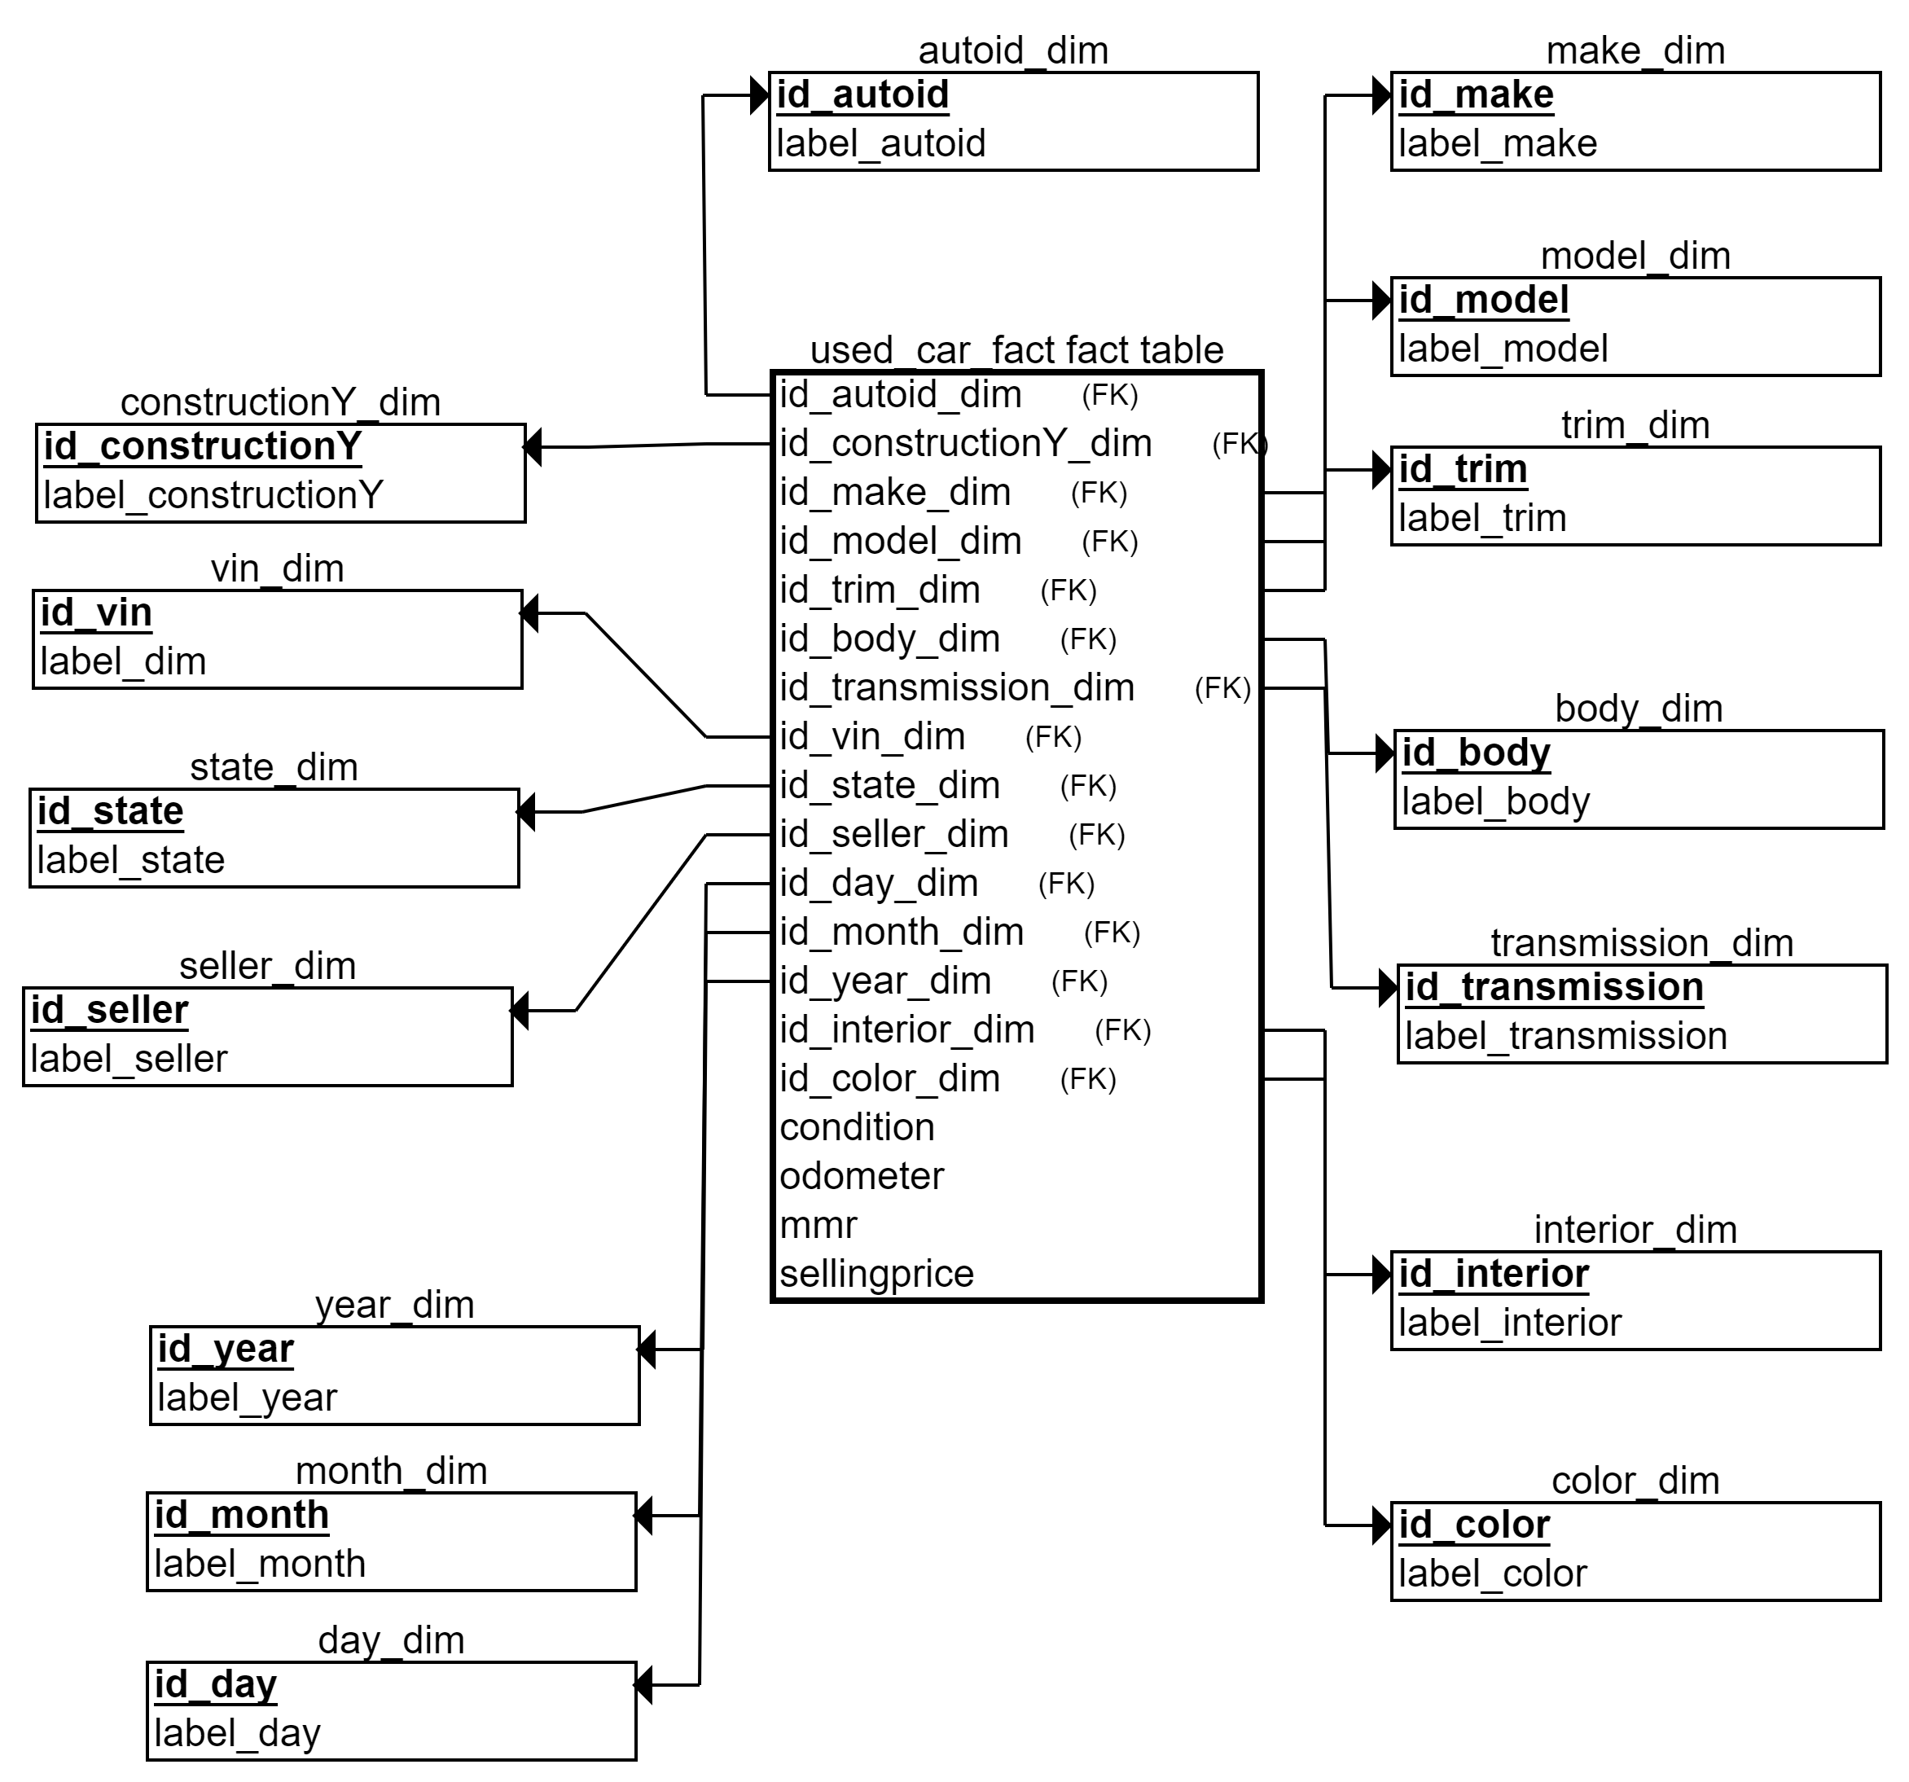

Slide 23

Import Data

Slide 24
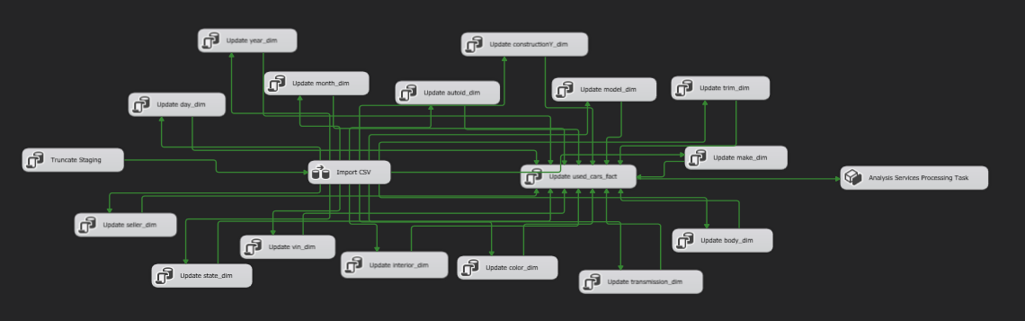

Slide 25
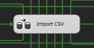
Import CSV

Slide 26
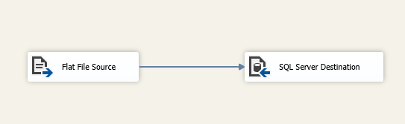
Import CSV

Slide 27
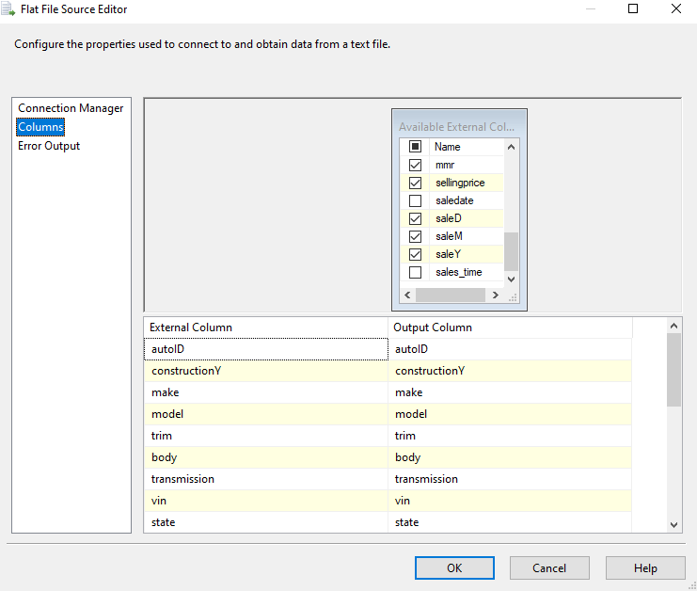
Import CSV

Slide 28
Import CSV

Slide 29
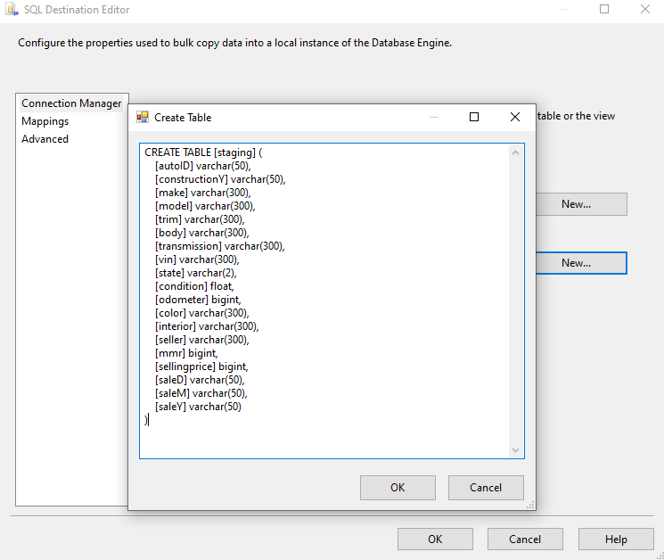
Import CSV

Slide 30
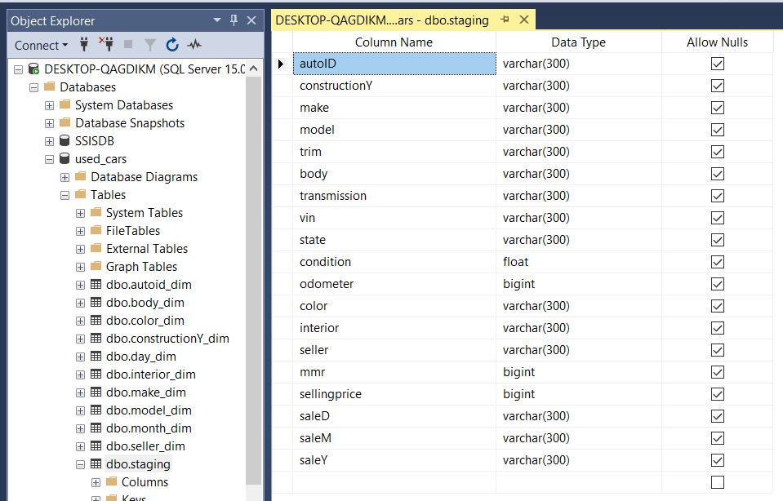

Slide 31
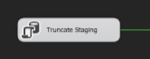
Truncate Staging

Slide 32
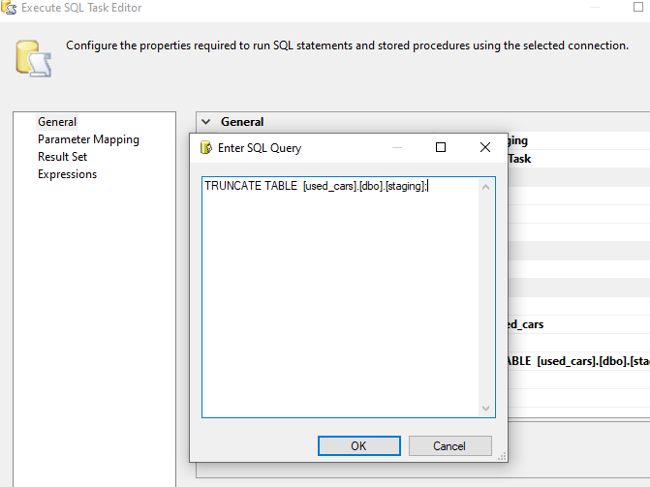
Truncate staging

Slide 33
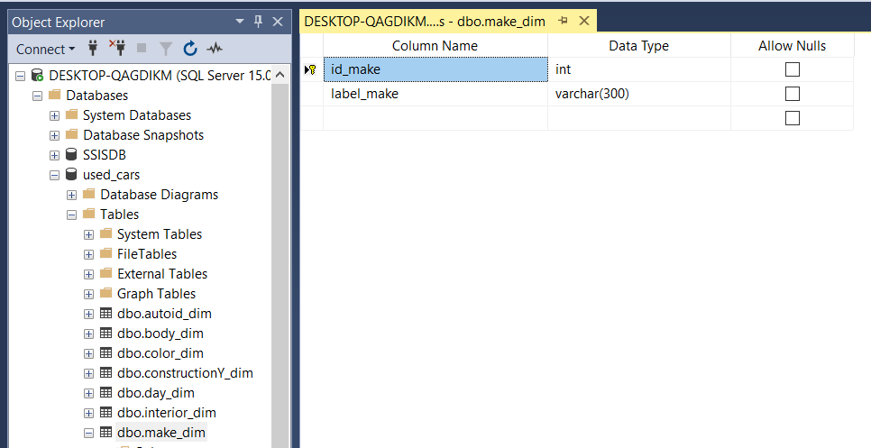
Create Dimension Tables

Slide 34
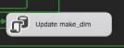
Insert Data to Dimension Tables

Slide 35
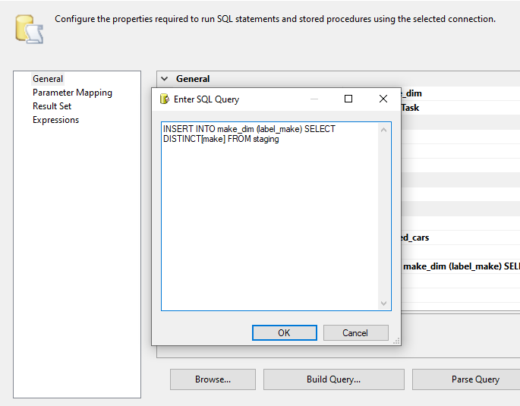
Insert Data to Dimension Tables

Slide 36
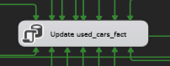
Create Fact Table

Slide 37
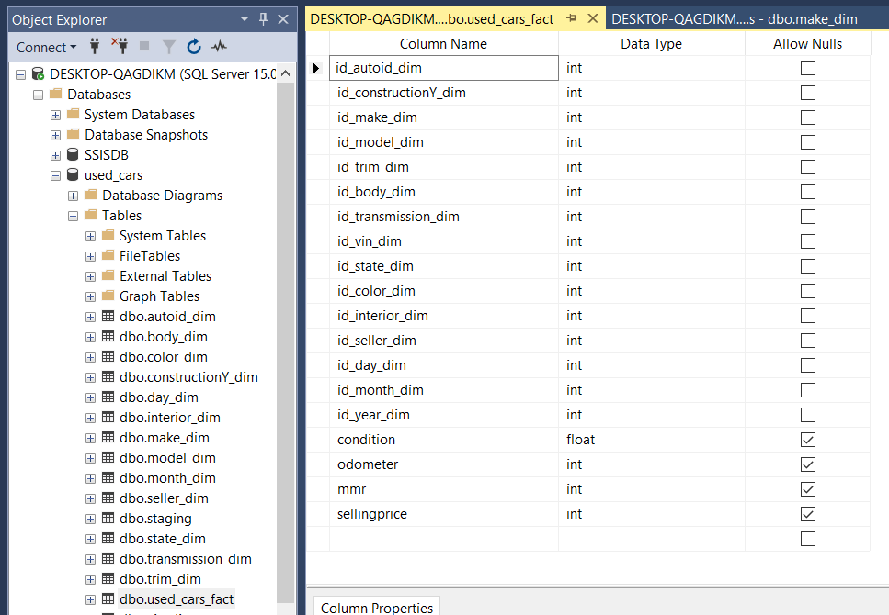
Create Fact Table

Slide 38
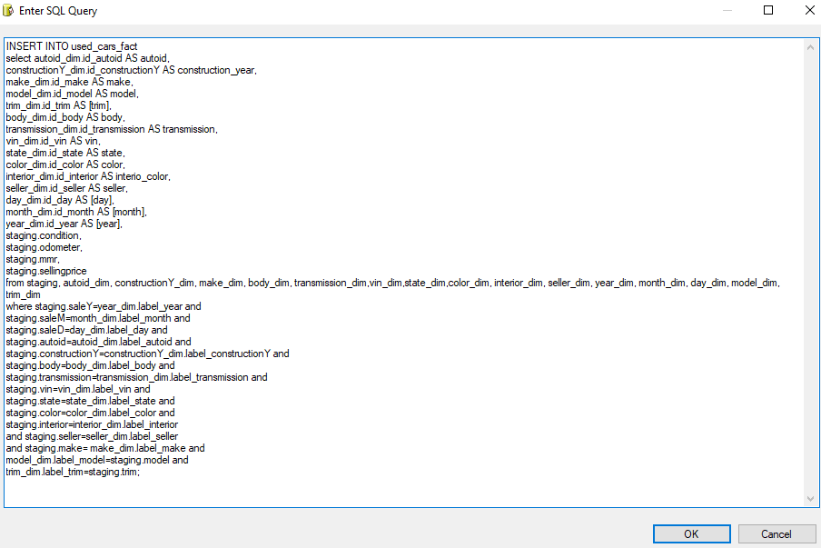
Insert Data to Fact Table

Slide 39

Create Cube

Slide 40
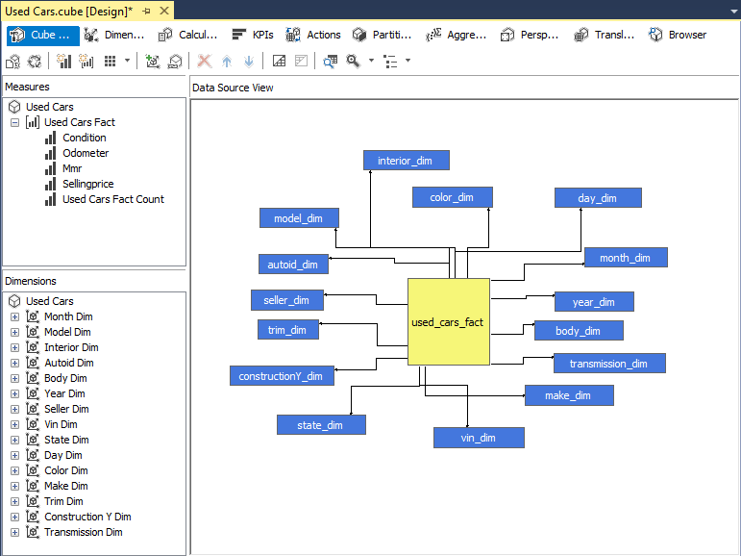
Create Cube
Measures & Dimensions:

Slide 41
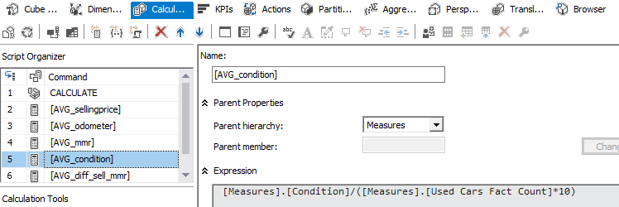
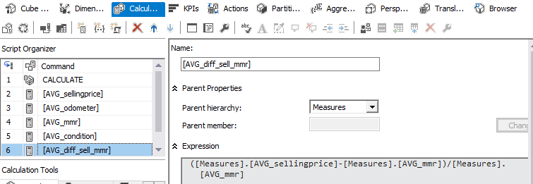
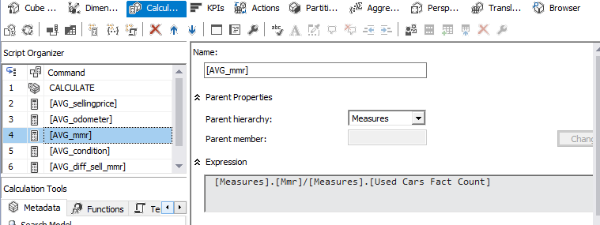
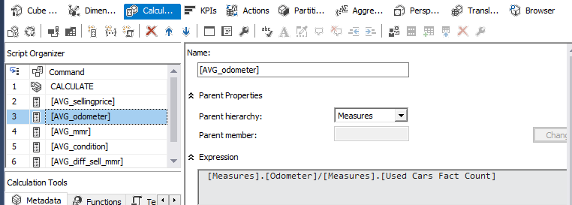
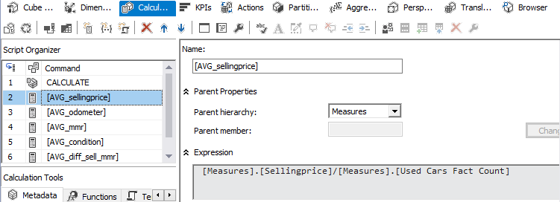
Create Cube
Calculated Measures:

Slide 42
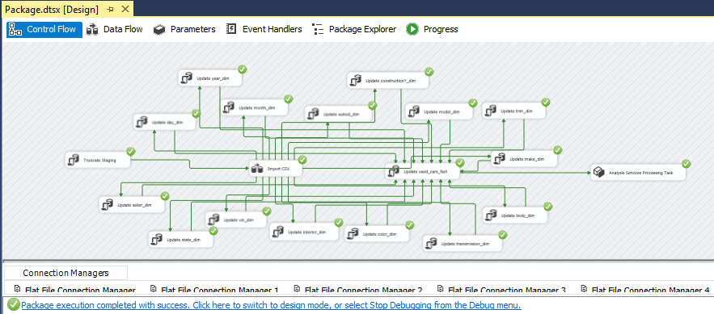
Create Cube

Slide 43

Power BI

Slide 44

Market Analysis

Slide 45
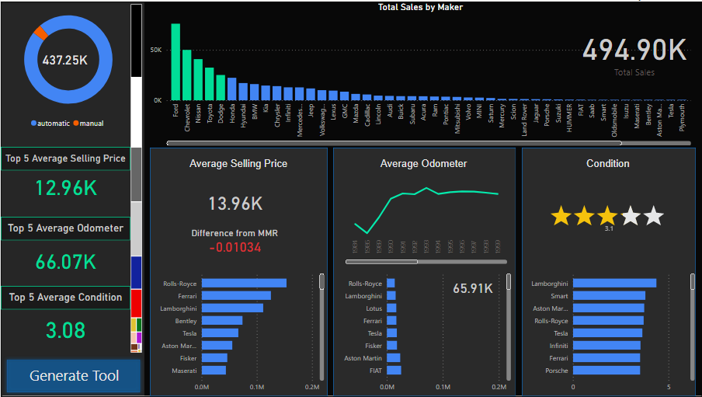

Slide 47
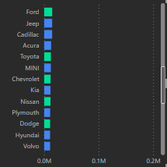

Slide 48
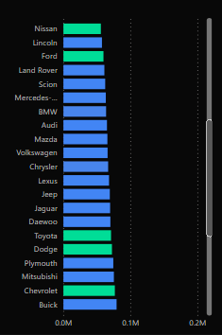

Slide 49
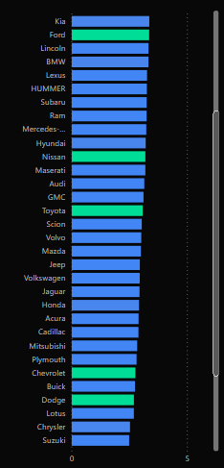

Slide 50

Selling price > Condition > Mileage
Condition
Odometer
Selling Price

Slide 52

Model Comparison Tool

Slide 53
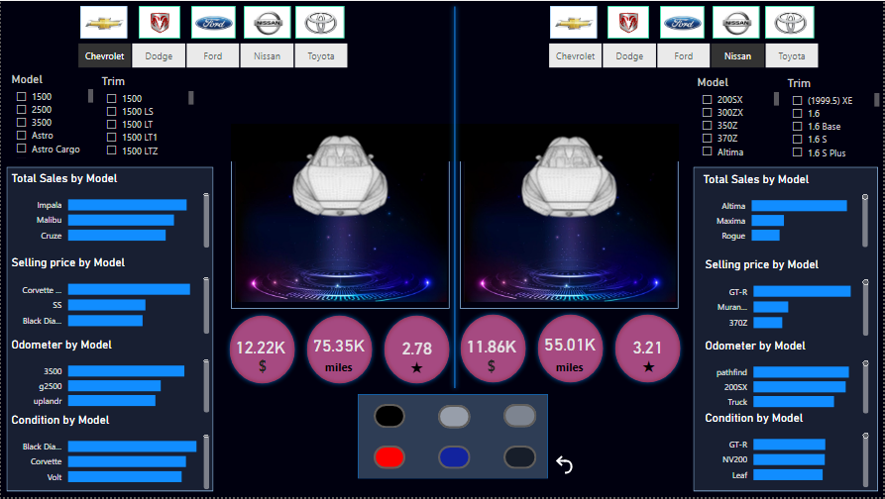

Slide 59
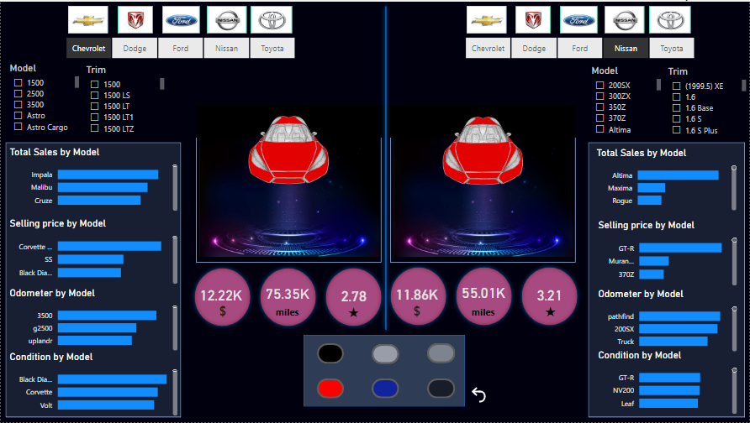

Slide 60
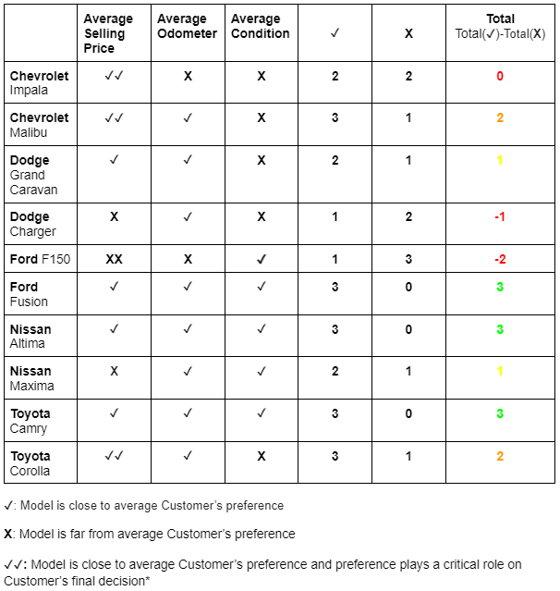
Score Card:

Slide 61
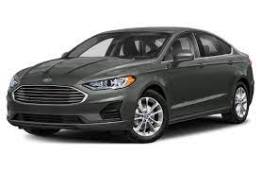
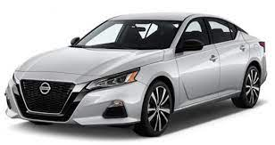
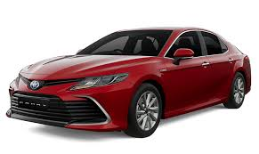
Best Fit Car Models
Chevrolet Malibu
Dodge Grand Caravan
Ford Fusion
Nissan Altima
Nissan Maxima
Toyota Camry
Toyota Corolla

Slide 62
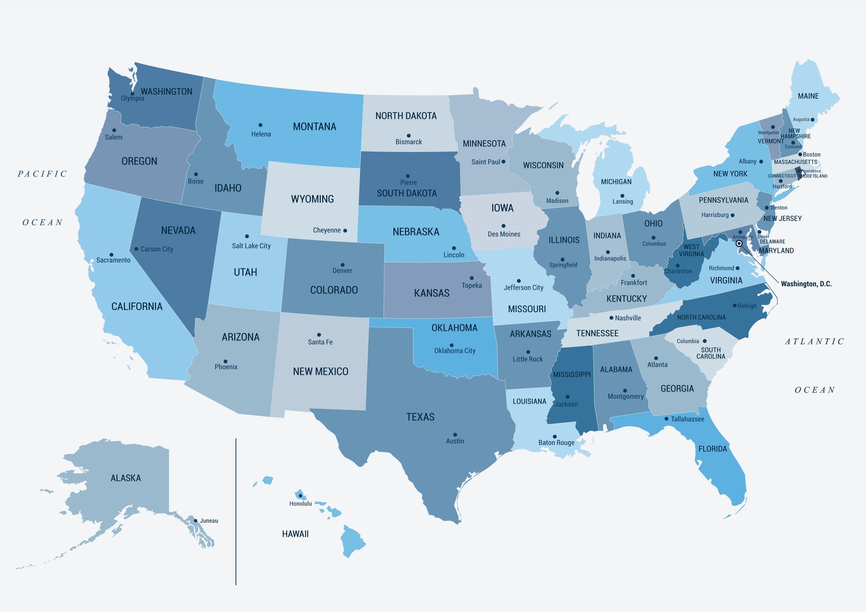
State Analysis

Slide 63
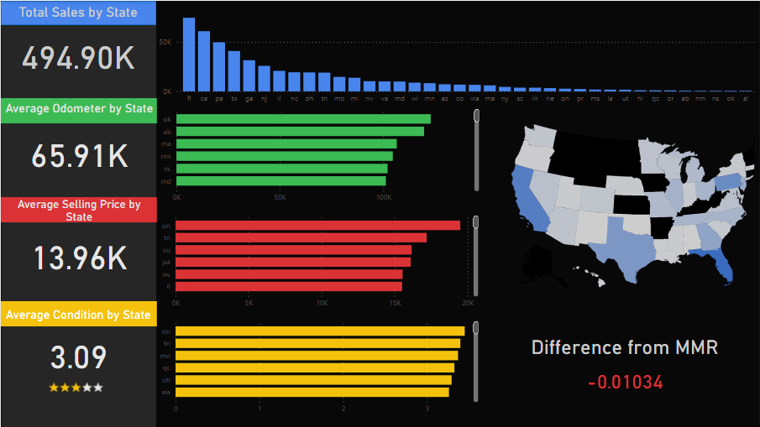

Slide 64


Slide 65


Slide 66

Conclusions

Slide 67
Conclusions
Top 5 makers represent 45% of market
Top 5 makers’ Customers prefer cars with slightly higher than average mileage when car’s condition is equal to average market’s condition and their selling price is at least $1k lower than the average market’s selling price.
Top Models to be supplied: Ford Fusion, Nissan Altima, Toyota Camry
Best State: California

Slide 68
Thank you!

Slide 69

Questions?

